Slide 1
Data Link Layer

Slide 2
The Data Link Layer
The second layer in our model
Works with whole units of information called frames (rather than individual bits, as in the physical layer)
This study deals with algorithms for achieving reliable, efficient communication

Slide 3
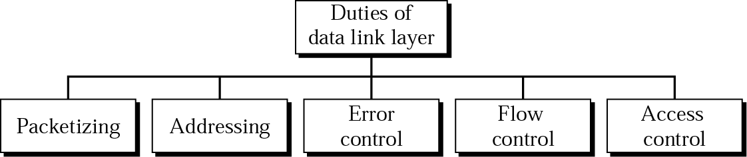
Framing

Slide 4
DATA LINK LAYER DESIGN ISSUES
The data link layer uses the services of the physical layer to send and receive bits over communication channels. It has a number of functions, including:
Providing a well-defined service interface to the network layer. (reference next slide)
Dealing with transmission errors.
Regulating the flow of data so that slow receivers are not swamped by fast senders.

Slide 5
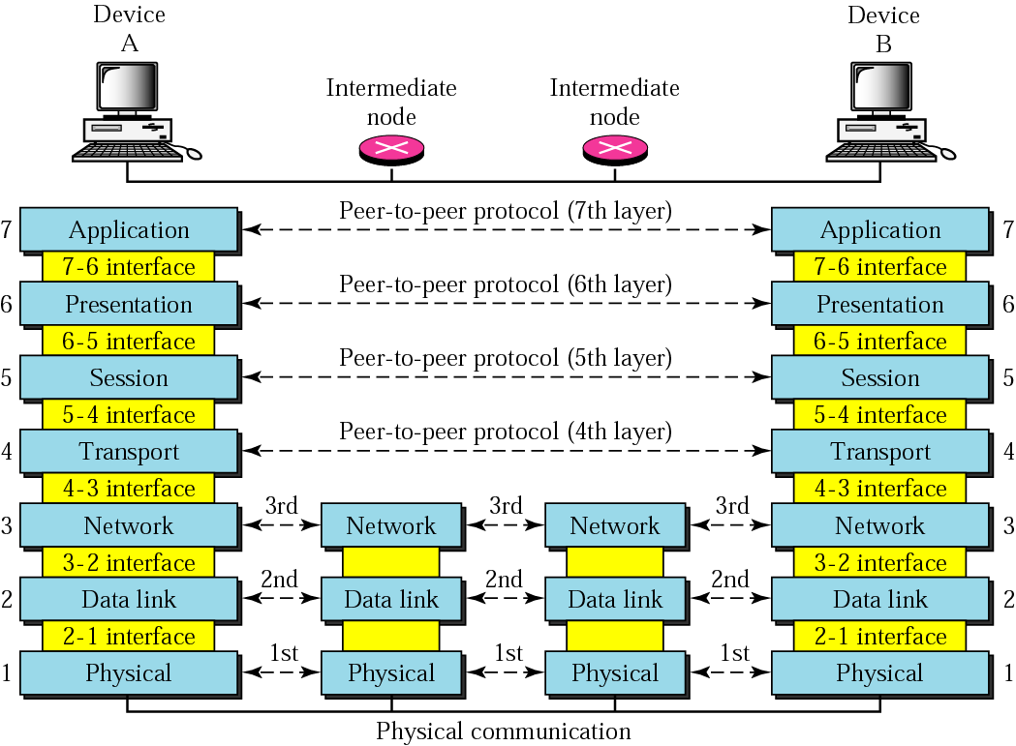
Figure 2-2
Architecture of OSI Model

Slide 6
Services Provided to the Network Layer
The principal service is transferring data from the source machine’s network layer to the destination machine’s network layer.
The data link layer can be designed to offer various services. Actual services that are offered vary from protocol to protocol. Three reasonable possibilities that we will consider in turn are:
1. Unacknowledged connectionless service. 2. Acknowledged connectionless service. 3. Acknowledged connection-oriented service. [no U/Ack + C-oriented service]

Slide 7
Unacknowledged connectionless service
Unacknowledged connectionless service consists of having the source machine send independent frames to the destination machine without having the destination machine acknowledge them.

Slide 8
Acknowledged connectionless service
The next step up in terms of reliability is acknowledged connectionless service.
When this service is offered, there are still no logical connections used, but each frame sent is individually acknowledged.

Slide 9
Acknowledged Connection-Oriented Service
The most sophisticated service the data link layer can provide to the network layer is connection-oriented service.
With this service, the source and destination machines establish a connection before any data transfer happen.

Slide 10
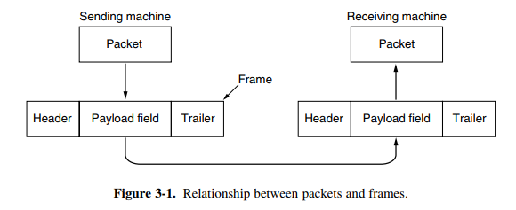
Frame
To accomplish it’s goals, the data link layer takes the packets it gets from the network layer and encapsulates them into frames for transmission.
Each frame contains a frame header, a payload field for holding the packet, and a frame trailer.

Slide 11
Framing
Data link layer breaks up the bit stream into discrete frames.
Breaking up the bit stream into frames is more difficult than it at first appears:
Methods of framing:
☑ Byte count.
☑Flag bytes with byte stuffing.
☑Flag bits with bit stuffing.
Physical layer coding violations

Slide 12
Byte Count
The first framing method uses a field in the header to specify the number of bytes in the frame.
When the data link layer at the destination sees the byte count, it knows how many bytes follow and hence where the end of the frame is.

Slide 13
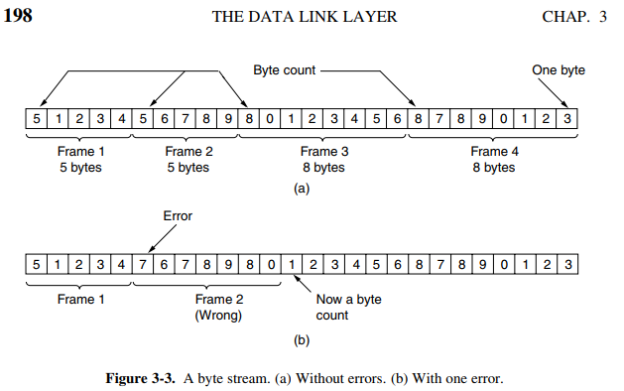
Byte Count
The trouble with this algorithm is that the count can be garbled by a transmission error.
Same frame wrong bit

Slide 14
Flag bytes with byte stuffing
The second framing method gets around the problem of resynchronization after an error by having each frame start and end with special bytes.
Often the same byte, called a flag byte.
Two consecutive flag bytes indicate the end of one frame and the start of the next.
However, there is a still a problem we have to solve. It may happen that the flag byte occurs in the data, especially when binary data such as photographs or songs are being transmitted. This situation would interfere with the framing.

Slide 15
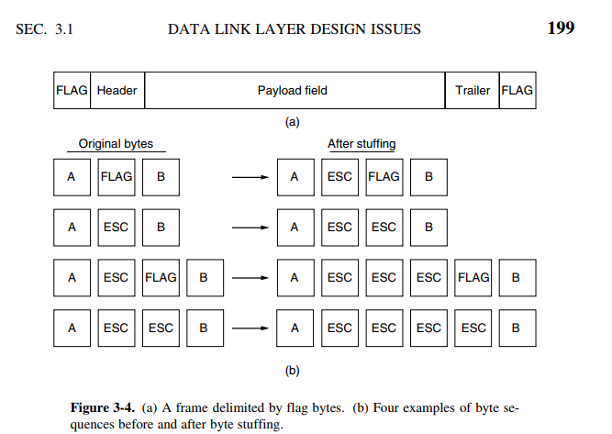
Flag bytes with byte stuffing
One way to solve this problem is to have the sender’s data link layer insert a special escape byte (ESC) just before each ‘‘accidental’’ flag byte in the data.

Slide 16
bit stuffing
The third method of delimiting the bit stream gets around a disadvantage of byte stuffing, which is that it is tied to the use of 8-bit bytes. Framing can be also be done at the bit level
so, frames can contain an arbitrary number of bits made up of units of any size.
Each frame begins and ends with a special bit pattern, 01111110 or (01111110)₂ = (126)₁₀ or 0x7E in hexadecimal. This pattern is a flag byte.
Whenever the sender’s data link layer encounters five consecutive 1s in the data, it automatically stuffs a 0 bit into the outgoing bit stream.

Slide 17
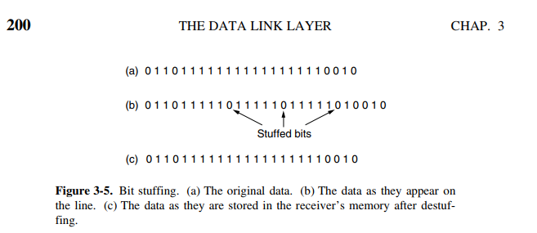
bit stuffing
When the receiver sees five consecutive incoming 1 bits, followed by a 0 bit, it automatically destuffs (i.e., deletes) the 0 bit. Just as byte stuffing is completely transparent to the network layer in both computers, so is bit stuffing. If the user data contain the flag pattern, 01111110, this flag is transmitted as 011111010 but stored in the receiver’s memory as 01111110.

Slide 18
Error Control
Data-link layer uses error control techniques to ensure that frames, i.e. bit streams of data, are transmitted from the source to the destination with a certain extent of accuracy.

Slide 19
Error
Networks must be able to transfer data from one device to another with complete accuracy.
The corrupted bits lead to false data being received by the destination and are called errors.
Some application require that errors be detected and corrected.
Errors can be of three types:
single bit errors
multiple bit errors
burst errors.
Error detection and correction are implemented either at the data link layer or the transport layer of the OSI model.

Slide 20
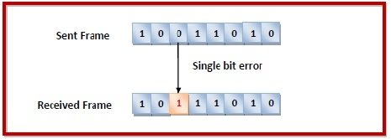
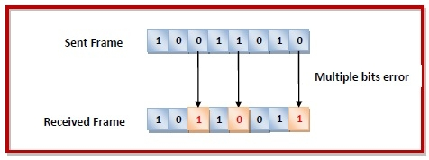
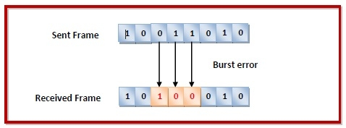
Error
Single bit error − In the received frame, only one bit has been corrupted, i.e. either changed from 0 to 1 or from 1 to 0.
Multiple bits error − In the received frame, more than one bits are corrupted.
Burst error − In the received frame, more than one consecutive bits are corrupted.

Slide 21
Error Detection & Correction
Error control can be done in two ways in DL Layer:
Error detection − Error detection involves checking whether any error has occurred or not. The number of error bits and the type of error does not matter.
Error correction − Error correction involves ascertaining the exact number of bits that has been corrupted and the location of the corrupted bits.
For both error detection and error correction, the sender needs to send some additional bits along with the data bits. The receiver performs necessary checks based upon the additional redundant bits. If it finds that the data is free from errors, it removes the redundant bits before passing the message to the upper layers.

Slide 22
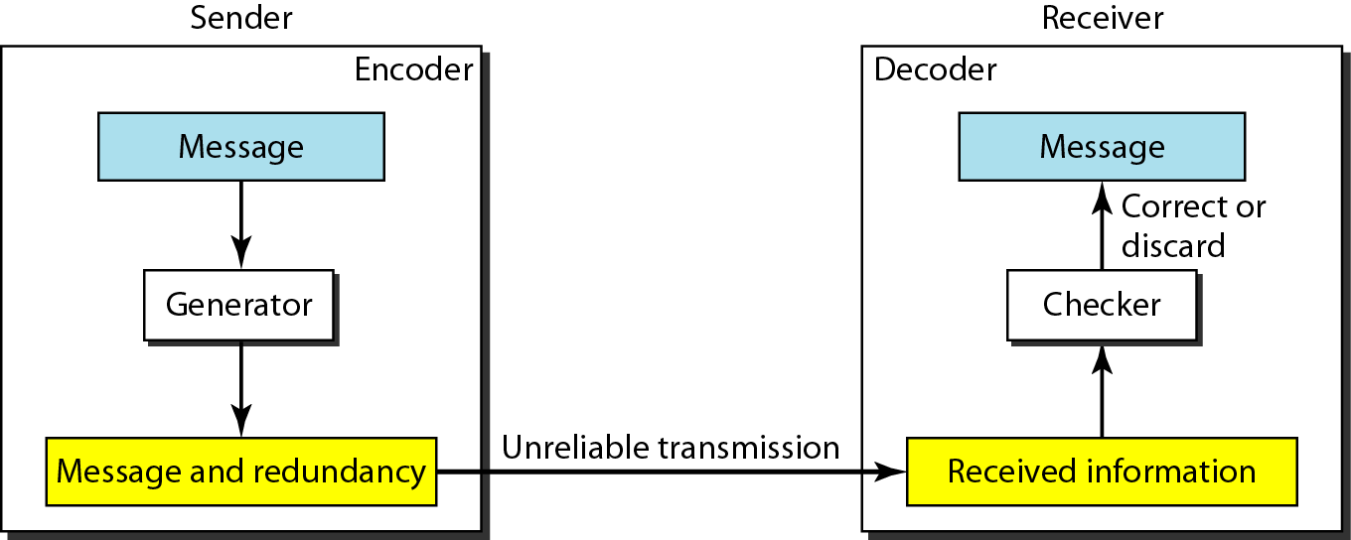
The structure of encoder and decoder

Slide 23
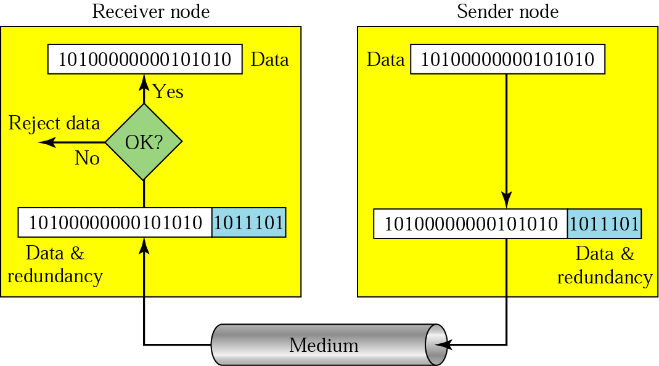
Detection(cont’d)
Redundancy

Slide 24
Error Detection Techniques

Slide 25
Error Detection Techniques:
There are three main techniques for detecting errors in frames: (used on fiber and high quality wire)
Parity Check ( 1D[simple] and 2D)
Cyclic Redundancy Check (CRC).
Checksum

Slide 26
Simple Parity Checking (or One-dimension Parity Check)
The most common and least expensive mechanism for error- detection is the simple parity check.
The parity check is done by adding an extra bit, called parity bit to the data to make a number of 1s either even (even parity) or odd (odd parity)
While creating a frame, the sender counts the number of 1s in it and adds the parity bit in the following way:
If a number of 1s is even then parity bit value is 0
If the number of 1s is odd then parity bit value is 1.

Slide 27
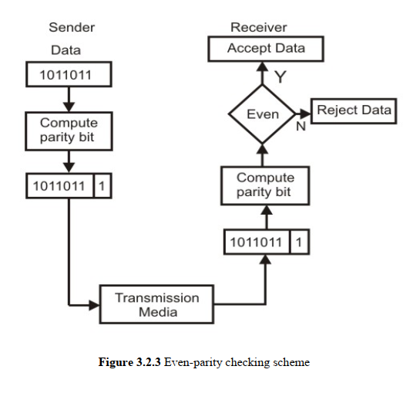
Simple Parity Checking (or One-dimension Parity Check)
The parity check is suitable for single bit error detection only.
A simple parity-cheek code can detect odd numbers of error.

Slide 28
2D Parity Checking
Performance can be improved by using two dimensional parity check.
Parity check bits are calculated for each row, which is equivalent to a simple parity check bit.
Parity check bits are also calculated for all columns then both are sent along with the data.

Slide 29
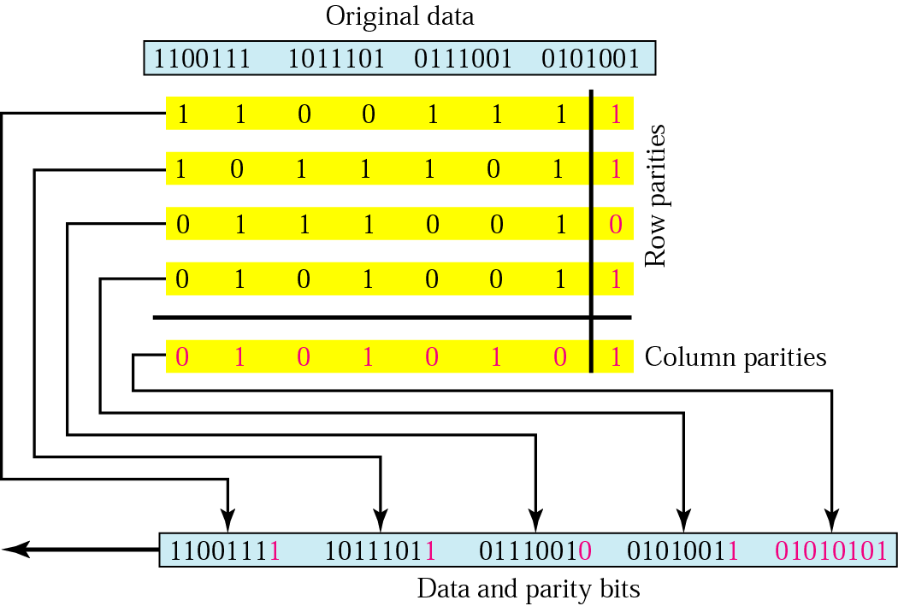
2D Parity Checking
Two- Dimension Parity Checking increases the likelihood of detecting burst errors.

Slide 30
Two-dimension parity
Data
1 0 0 1 0 0
0 1 0 0 0 1
1 0 0 1 0 0
1 1 0 1 1 0
1 0 0 1 1 1
Data blocks are organized into table
Last column: check bits for rows
Last row: check bits for columns
Can detect and correct single bit error
Red bits are errors
Parity bits
1 0 0 1 0 0 0
0 0 0 0 0 1 1
1 0 0 1 0 0 0
1 1 0 1 1 0 0
1 0 0 1 1 1 0
0 1 0 0 0 0
1 0 0 1 0 0 0
0 0 0 0 0 1 1
1 0 0 1 0 0 0
1 0 0 1 1 0 1
1 0 0 1 1 1 0
0 0 0 0 0 0 0
1 0 0 1 0 0 0
0 0 0 1 0 1 0
1 0 0 1 0 0 0
1 0 0 1 1 0 1
1 0 0 1 1 1 0
0 0 0 1 0 0
1 0 0 1 0 0
0 0 0 1 0 1
1 0 0 1 0 0
1 0 0 0 1 0
1 0 0 1 1 1
0
1 error
2 errors
3 errors
4 errors
Can detect one, two, three errors,
But NOT all four errors.
Checking bits

Slide 31
Checksum
Sender site:
In checksum error detection scheme, the data is divided into k segments each of n bits.
In the sender’s end the segments are added using 1’s complement arithmetic to get the sum.
The sum is complemented to get the checksum.
The checksum segment is sent along with the data segments
Receiver End:
At the receiver’s end, all received segments are added using 1’s complement arithmetic to get the sum
The sum is complemented.
If the result is zero, the received data is accepted; otherwise discarded

Slide 32
Checksum

Slide 33
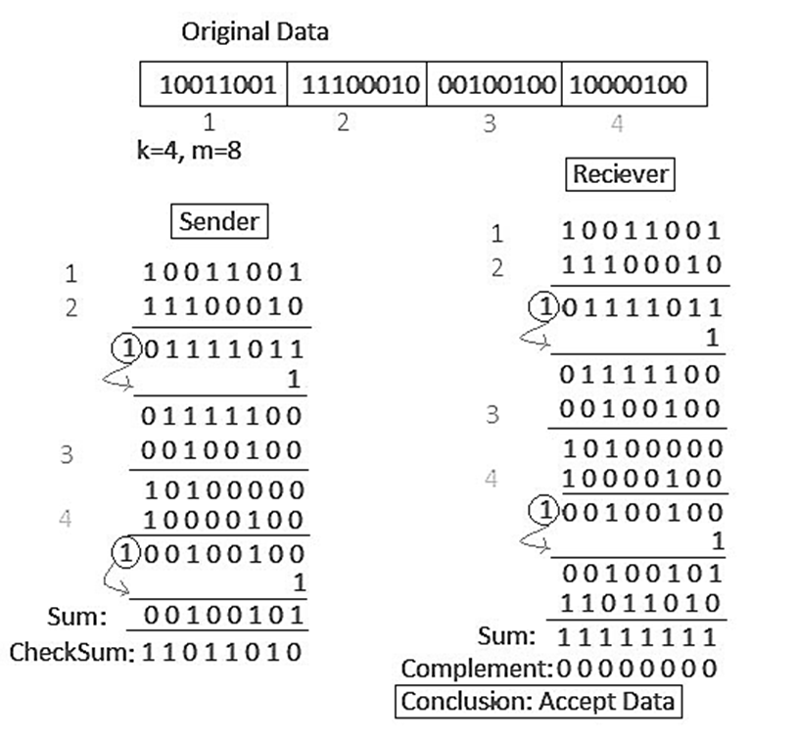

Slide 34
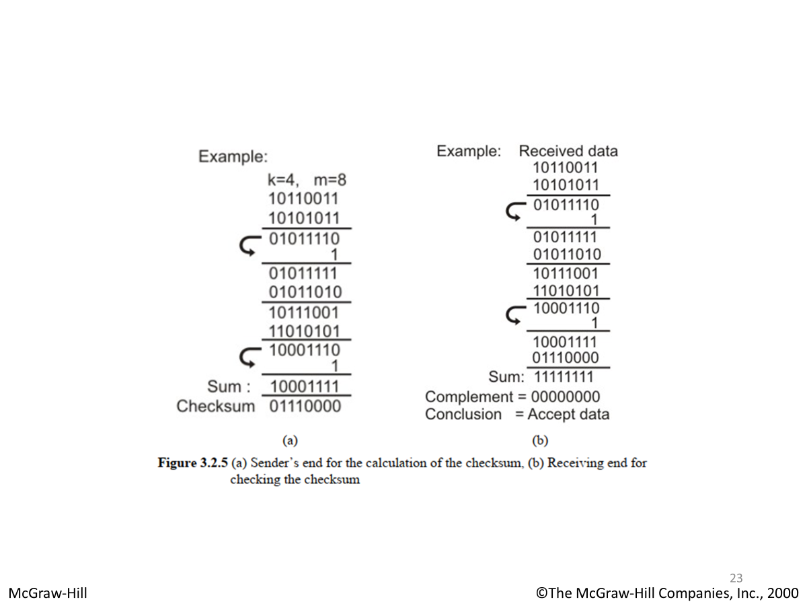

Slide 35
Suppose the following block of 16 bits is to be sent using a checksum of 8 bits.
10101001 00111001
What will be the data sent to the receiver?
The numbers are added using one’s complement
10101001
00111001 ------------ Sum 11100010
Checksum 00011101
The pattern sent is 10101001 00111001 00011101

Slide 36
Now suppose the receiver receives given the pattern sent using 8-bit checksum:
10101001 00111001 00011101
Check if there is any error.
When the receiver adds the three sections, it will get all 1s, which, after complementing, is all 0s and shows that there is no error.
10101001
00111001
00011101
Sum 11111111
Complement 00000000 means that the pattern is OK.

Slide 37
Error Correction Techniques

Slide 38
Error correction methods: (used on wireless links = high error environments)
Hamming code
Binary convolutional code
Reed-Solomon and Low-Density Parity Check code (Mathematically complex, widely used in real systems)

Slide 39
Error Correction
It can be handled in two ways:
receiver can have the sender retransmit the entire data unit.
The receiver can use an error-correcting code, which automatically corrects certain errors.

Slide 40
Error Correction
A technique developed by R.W.Hamming provides a practical solution
The solution or coding scheme he developed is commonly known as Hamming Code.
Basic approach for error detection by using Hamming code is as follows:
To each group of m information bits k parity bits are added to form (m+k) bit code
The k parity bits are placed in positions 1, 2, …, 2k-1 positions.–K parity checks are performed on selected digits of each codeword
At the receiving end the parity bits are recalculated. The decimal value of the k parity bits provides the bit-position in error, if any.

Slide 41
Hamming Code

Slide 42
Hamming Code

Slide 43
Hamming Code

Slide 44
Example of Hamming Code

Slide 45
Single-bit error

Slide 46
2`r >= m + r +1
Error
Detection

Slide 47

Hamming code (Watch this vid.)

Slide 48
The End

